Slide 1
REACT MEETUP HAMBURG
FLUX INTRODUCTION
Nils Hartmann (nils@nilshartmann)

Slide 2
REACT MEETUP HAMBURG
WHY FLUX?
Some background first...

Slide 3
SINGLE COMPONENT HIERARCHIE
Communication
Down via properties
Up via callbacks
Top-level component
Works on single model
(whatever a ‚model‘ is)
Notes:
RENE

Slide 4
MULTIPLE COMPONENT HIERARCHIES (I)
Isolated Models with independent component trees
Each component (tree) works on its own model
Peaceful co-exsitence
Notes:
RENE

Slide 5
MULTIPLE COMPONENT HIERARCHIES (II)
Shared Model with independent component trees
Each component (tree) works on the same model
Can be confusing: who‘s taking responsibility? Can lead to back loops
Notes:
RENE

Slide 6
MULTIPLE COMPONENT HIERARCHIES (III)
NOTWENDIG???
Im Prinzip eine Abwandlung von der Folie davor:
Date exchange between component trees
Independent component trees wants to exchange data
Notes:
RENE

Slide 7
REACT MEETUP HAMBURG
FLUX

Slide 8
FLUX
„Application architecture for building user interfaces“
http://facebook.github.io/flux/
Design pattern, not a framework
Various implementations and interpretations
Not tied to React
Introduces unidirectional data flow

Slide 9
UNI-DIRECTIONAL DATA FLOW - 1
Component triggers an Action using an ActionCreator
<button onClick={()=> {
UserActionCreators.addUser(...);
}} />

Slide 10
UNI-DIRECTIONAL DATA FLOW - 2
ActionCreator sends Action to Central Dispatcher
addUser(name) {
Dispatcher.dispatch({
type: ‘USER_ADD_ACTION‘,
payload: { user: name }
});
}
(UserActionsCreator)

Slide 11
UNI-DIRECTIONAL DATA FLOW - 3
Dispatcher forwards the Action to Store

Slide 12
UNI-DIRECTIONAL DATA FLOW - 4
Store processes Action and emits a change event
handleAction(action){
if (action.type===‘USER_ADD_ACTION‘) {
this.users.push(action.payload.user); emitStoreChangeEvent();
}
}
(UserStore)

Slide 13
UNI-DIRECTIONAL DATA FLOW - 5
Component receives event and updates its state
onUserStoreChange() {
this.setState(
{users: UserStore.getAllUsers();}
);
}

Slide 14
FLUX ELEMENTS IN DETAILS
Note: different implementations interpret differently

Slide 15
COMPONENT
„Regular“ React component
Triggers an action, e.g. on user interaction
Listens to one or more Stores
Derives its state from Store
Update children from render() method
Controller Component
Top-level component should be the only component interacting with Flux
Grafik: Componente verschickt Action und horcht auf Store

Slide 16
ACTION and ACTIONCREATOR
Action
Represents semantic event happend in the app
Has an identifying „type“ (USER_ADDED)
Contains information what happend (Name of new user)
Can be triggered by Components or external events
An Action cannot trigger Another action
ActionCreator
Factory for Actions
Ensures integrity of action object,
Semantic methods (addUser)
Pass Action to Dispatcher

Slide 17
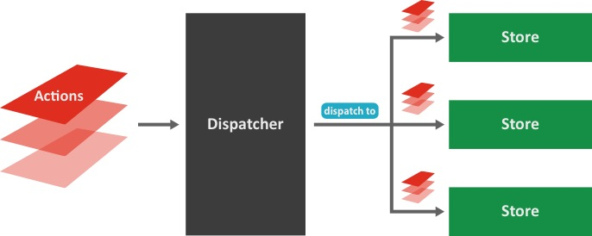
DISPATCHER
Pure technical component, no business logic
Forwards Actions to all known Stores
Only one Dispatcher in your application (singleton)

Slide 18
STORE
Contains the business logic for a specific domain
Conntect to the central Dispatcher via callback method
Process only Actions they are interessted in (eg filter by type)
Emit events after changing their state

Slide 19
UNI-DIRECTIONAL DATA FLOW - EXAMPLES
Very flexible scenarios…

Slide 20
UNI-DIRECTIONAL DATA FLOW - EXAMPLE 1
...Action can be dispatched to multiple stores
...A component can listen to multiple stores...

Slide 21
UNI-DIRECTIONAL DATA FLOW - EXAMPLE 2
...Multipe components can listen to same store, working on same domain „model“...

Slide 22
UNI-DIRECTIONAL DATA FLOW - EXAMPLE 3
...“external events“ (e.g. response from server) can trigger actions
Flow is still the same

Slide 23
UNI-DIRECTIONAL DATA FLOW - EXAMPLE 3
...“external events“ (e.g. response from server) can trigger actions
Flow is still the same

Slide 24
SUMMARY
Defined flow of data
Easy to track
Recordable
Lots of new vocabular
eg: what is the shape of a Store?

Slide 25
REACT MEETUP HAMBURG
THANK YOU!
Slides:
https://github.dst.tk-inline.net/nilshartmann/flux-intro

